Slide 1
Dependency Inversion Principle (DIP) – SOLID Principles
Group 4

Slide 2

Introduction
The Dependency Inversion Principle is the D in the SOLID principles of object-oriented design.
It helps make software systems more flexible, maintainable, and decoupled.
High-level modules should not depend on low-level modules. Both should depend on abstractions.
Abstractions should not depend on details. Details should depend on abstractions.

Slide 3
Why?
Without DIP:
High-level code (business logic) directly depends on low-level code (implementations, database calls, etc.).
Changing the low-level part forces changes in the high-level part → tight coupling.
With DIP:
Both high-level and low-level code depend on an interface or abstract class.
You can swap implementations without touching business logic → loose coupling and easier testing.

Slide 4
What does that mean?
In traditional programming, high-level modules (which contain business logic) often depend directly on low-level modules (like database access or file systems). This tight coupling makes the system hard to change or extend.
DIP suggests that both high-level and low-level modules should depend on interfaces or abstract classes, not on concrete implementations.

Slide 5
Traditional Design | DIP-Compliant Design
High-level depends on low-level | Both depend on abstraction
Tight coupling | Loose coupling
Hard to test | Easy to test
Difficult to extend | Flexible and scalable

Slide 6
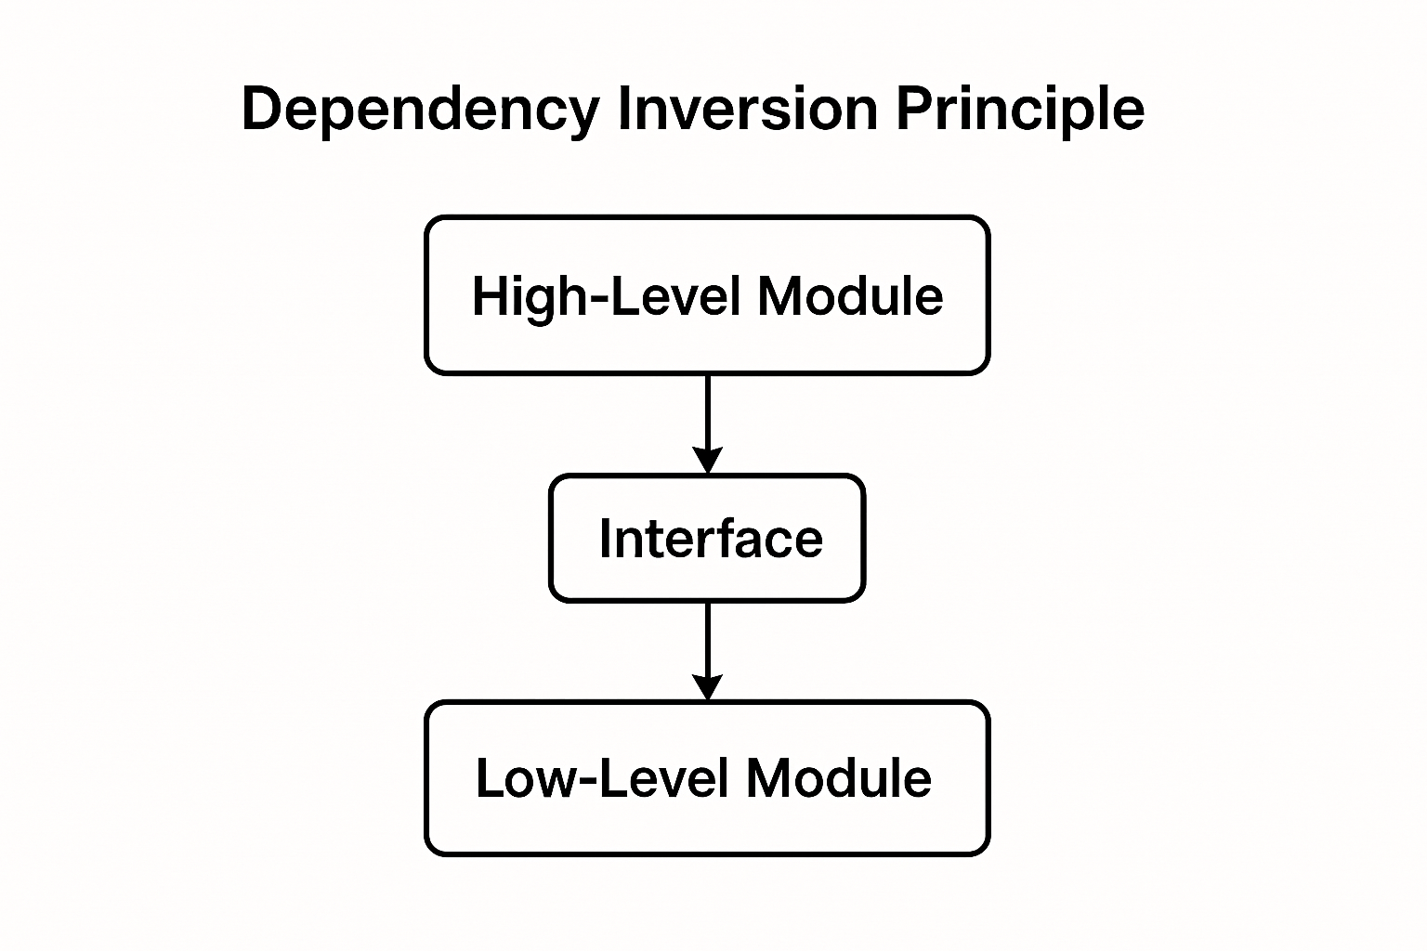

Slide 7

Benefits of DIP
Promotes loose coupling between components.
Makes code easier to test (e.g., using mocks ).
Improves flexibility and scalability.
Encourages clean architecture and dependency injection.

Slide 8
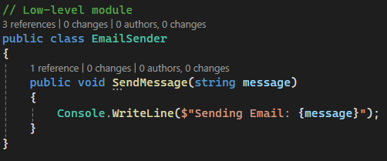
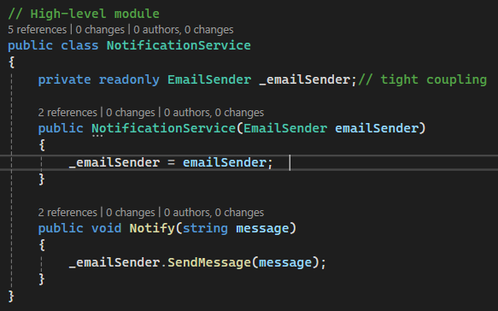
Example Without DIP

Slide 9
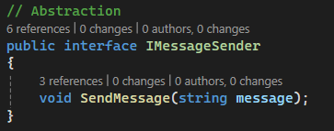
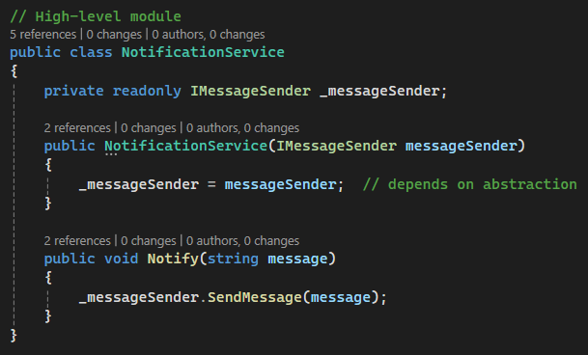
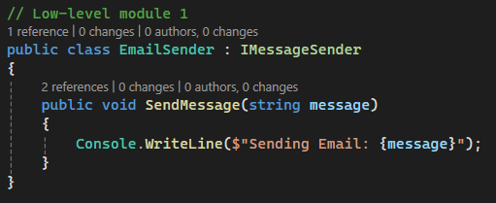
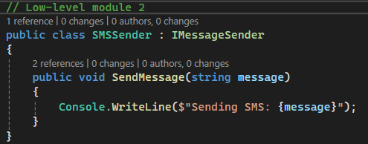
With DIP

Slide 10
Conclusion: Why DIP Matters
The Dependency Inversion Principle is a cornerstone of clean, maintainable software architecture.
It encourages decoupling between high-level and low-level modules, making systems more flexible, testable, and scalable.
By depending on abstractions, not concrete implementations, developers can:
Easily swap components
Implement unit testing with mocks
Support future enhancements with minimal changes
DIP is especially powerful when combined with Dependency Injection and other SOLID principles.

Slide 11

Thank you

